Slide 1
Deep Learning Approach in AI for Sentiment Analysis

Slide 2
Index
Abstract
Introduction
Literature Review/Related Works
Details of Topics
Real-world Applications
Future Direction
Conclusion

Slide 3
Abstract
Welcome to the presentation on "Deep Learning Approach in AI for Sentiment Analysis."
In this session, we will explore how Deep Learning models have revolutionized sentiment analysis, enabling more accurate and nuanced emotion classification.

Slide 4
Introduction
Sentiment Analysis, also known as Opinion Mining, is a natural language processing task that involves determining emotions or opinions expressed in textual data.
Traditional approaches to sentiment analysis relied on handcrafted features and shallow machine learning models. However, Deep Learning has revolutionized sentiment analysis by leveraging the power of neural networks to capture complex patterns and dependencies in textual data.

Slide 5
Literature Review/Related works What is Deep Learning?
Deep Learning is a subset of machine learning that utilizes neural networks with multiple hidden layers to learn hierarchical representations from data.
Neural Networks: Basic building blocks of Deep Learning, inspired by the human brain's interconnected neurons.

Slide 6
Recurrent Neural Networks (RNNs)
Recurrent Neural Networks (RNNs) are designed to process sequential data, making them suitable for sentiment analysis of text.
RNN Architecture: Recurrent connections enable the network to maintain hidden states and process sequences step-by-step.
Application in Sentiment Analysis: RNNs can capture context and temporal dependencies in textual data, aiding emotion classification.

Slide 7
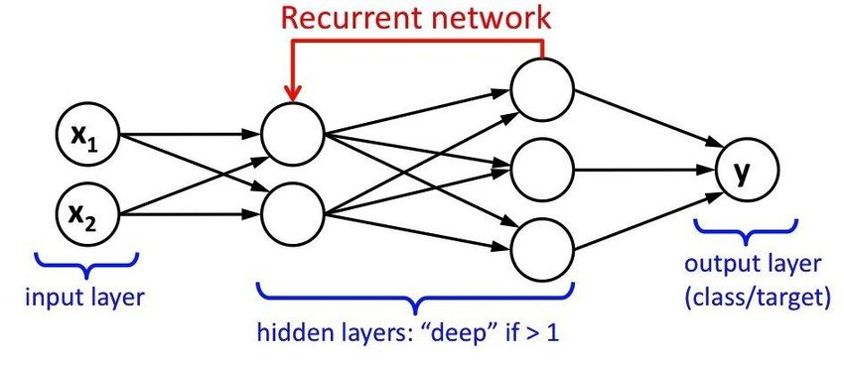

Slide 8
Long Short-Term Memory (LSTM)
Long Short-Term Memory (LSTM) is an advanced RNN variant that overcomes the vanishing gradient problem and retains long-term dependencies.
LSTM Architecture: Memory cells and gates enable LSTMs to learn and forget information as needed.
Advantages in Sentiment Analysis: LSTMs can capture complex linguistic patterns and context, improving sentiment classification.

Slide 9
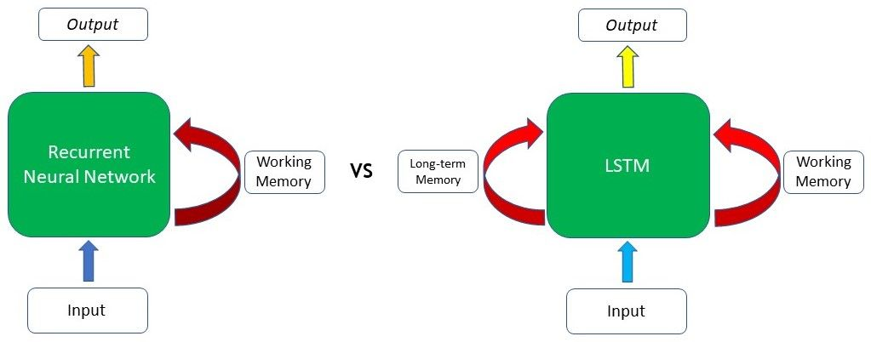

Slide 10
Transformer-based Models (e.g., BERT)
Transformer Architecture: Introduced by "Attention is All You Need," it uses attention mechanisms to parallelize computations in sequential data.
BERT (Bidirectional Encoder Representations from Transformers): A popular pre-trained language model that captures bidirectional context in text.
BERT in Sentiment Analysis: Fine-tuning BERT for specific sentiment classification tasks has shown remarkable performance improvements.

Slide 11
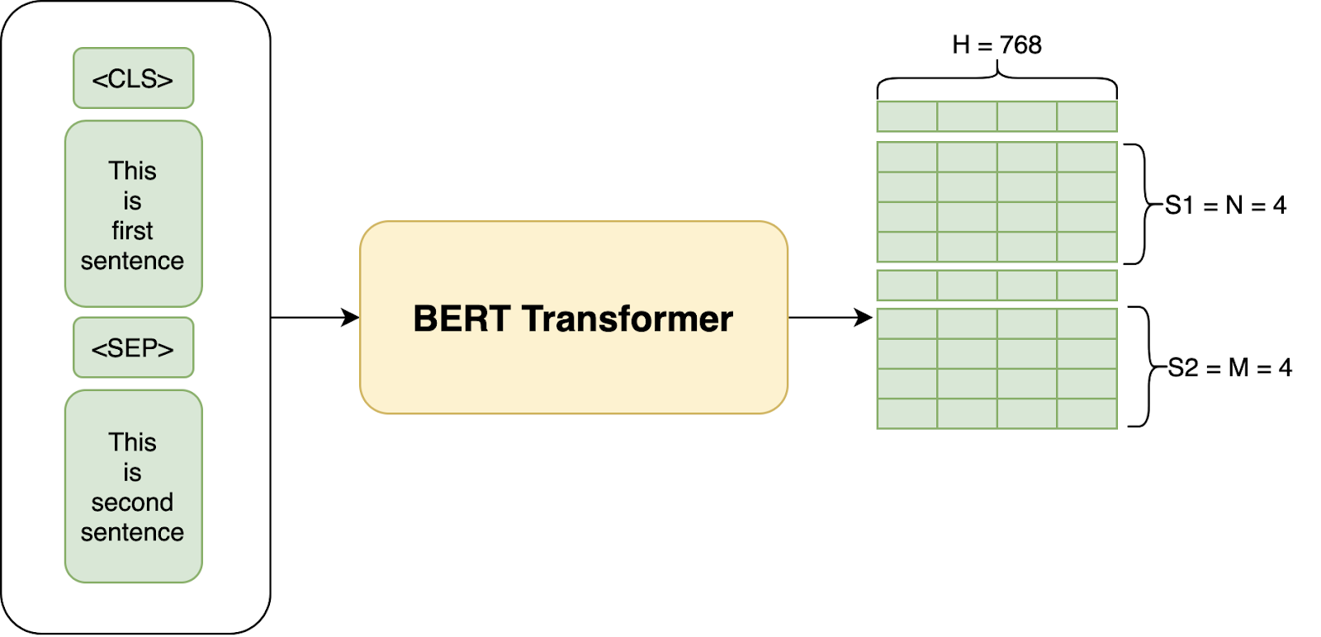

Slide 12
Experimental Results and Performance
Comparative analysis of Deep Learning models (RNNs, LSTM, BERT) with traditional Machine Learning approaches in sentiment analysis.
Performance Metrics: Accuracy, Precision, Recall, F1-score, and ROC-AUC for each model.
Discussion on the impact of hyperparameters and model architecture on results.

Slide 13
Real-world Applications
Real-world applications of Deep Learning in Sentiment Analysis across various industries and domains.
Social Media Sentiment Monitoring: Brand reputation management and customer feedback analysis.
Customer Sentiment Analysis: Improving product and service offerings based on customer opinions.

Slide 14
Future Directions
Ongoing research and advancements in Deep Learning for Sentiment Analysis.
Challenges and potential areas of improvement, such as handling sarcasm and irony.
The role of Deep Learning in advancing the field of Natural Language Processing.

Slide 15
Conclusion
Understanding the impact of RNNs, LSTM, and Transformer-based models in capturing the emotions from textual data.
Though deep learning-based sentiment analysis has shown great potential, there are still some limitations such as data quality, overfitting, and interpretability that need to be addressed in future research.

Slide 16
Thank you !

